Slide 1
Cyclist Bike Share Analysis
(PowerBI)

Slide 2
Data Cleaning
Removed The Unwanted Columns Which are Not Applicable to The Analysis By Using PowerBI
Open the Powerquery Tab and Remove Unwanted Column
Replacing Nulls To the Empty Values

Slide 3
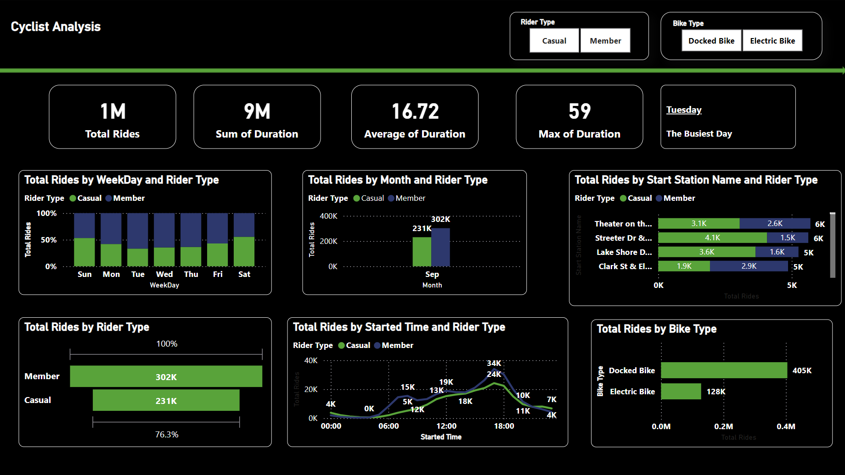
DashBoard
Total ride duration and ride counts by weekend and rider type
Total rides by month and rider type
Total rides by rider type
Total rides by start time and rider type
Total rides by start station and rider type
Busiest day

Slide 4
Three Recommendations based on Analysis
Enhance Weekend Services: Provide additional support and resources for rides on weekends to meet higher demand.
Improve High-Demand Stations: Allocate more bikes or vehicles to stations with the highest ride volumes.
Target Rider Preferences: Tailor promotions and services based on rider types and their preferred times and stations to boost satisfaction and usage.

